Slide 1
Data Mining
Anomaly Detection
© Tan,Steinbach, Kumar Introduction to Data Mining 4/18/2004 <number>

Slide 2
Anomaly/Outlier Detection
What are anomalies/outliers?
  The set of data points that are considerably different than the remainder of the data
Variants of Anomaly/Outlier Detection Problems
  Given a database D, find all the data points x ∈ D with anomaly scores greater than some threshold t
  Given a database D, find all the data points x ∈ D having the top-n largest anomaly scores f(x)
  Given a database D, containing mostly normal (but unlabeled) data points, and a test point x, compute the anomaly score of x with respect to D
Applications:
  Credit card fraud detection, telecommunication fraud detection, network intrusion detection, fault detection

Slide 3
Anomaly Detection
Challenges
  How many outliers are there in the data?
  Method is unsupervised
    Validation can be quite challenging (just like for clustering)
  Finding needle in a haystack
Working assumption:
  There are considerably more “normal” observations than “abnormal” observations (outliers/anomalies) in the data

Slide 4

Anomaly Detection Schemes
General Steps
  Build a profile of the “normal” behavior
    Profile can be patterns or summary statistics for the overall population
  Use the “normal” profile to detect anomalies
    Anomalies are observations whose characteristics
    differ significantly from the normal profile
Types of anomaly detection
schemes
  Graphical-based
  Statistical-based
  Distance-based

Slide 5
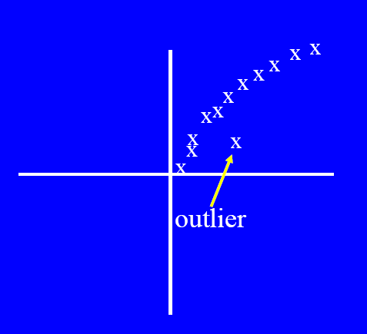
Graphical Approaches
Boxplot (1-D), Scatter plot (2-D), Spin plot (3-D)
Limitations
  Time consuming
  Subjective

Slide 6
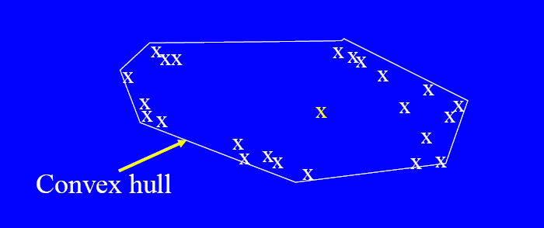
Convex Hull Method
Extreme points are assumed to be outliers
Use convex hull method to detect extreme values

Slide 7

Statistical Approaches
Assume a parametric model describing the distribution of the data (e.g., normal distribution)
Apply a statistical test that depends on
  Data distribution
  Parameter of distribution (e.g., mean, variance)
  Number of expected outliers (confidence limit)

Slide 8
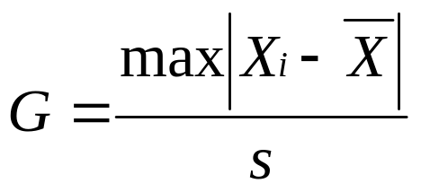
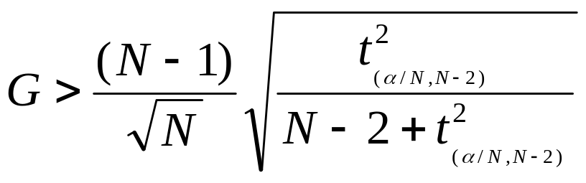
Grubbs’ Test
Detect outliers in univariate data
Assume data comes from normal distribution
Detects one outlier at a time, remove the outlier, and repeat
  H₀: There is no outlier in data
  H_{A}: There is at least one outlier
Grubbs’ test statistic:
Reject H₀ if:
t_{α/(2N),N−2} denotes the upper critical value of the t-distribution with N − 2 degrees of freedom and a significance level of α/(2N)

Slide 9
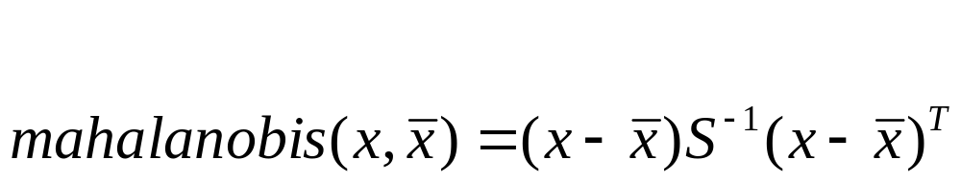
Mahalanobis Distance
Detect outliers in multivariate data
Mahalanobis Distance is a measure of the distance between a point P and a distribution D
  the closer the point in question is to this center of mass, the more likely it is to belong to the set
  if the distance between the test point and the center of mass is less than one standard deviation, then it is highly probable that the test point belongs to the set

Slide 10
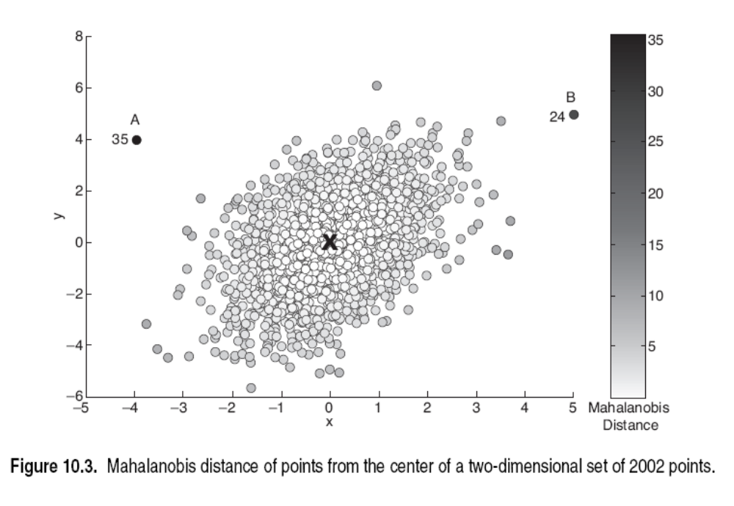
A is an outlier, B may not be an outlier

Slide 11
Statistical-based – Likelihood Approach
Assume the data set D contains samples from a mixture of two probability distributions:
  M (majority distribution)
  A (anomalous distribution)
General Approach:
  Initially, assume all the data points belong to M
  Let L_{t}(D) be the log likelihood of D at time t
  For each point x_{t} that belongs to M, move it to A
    Let L_{t+1} (D) be the new log likelihood.
    Compute the difference, Δ = L_{t}(D) – L_{t+1} (D)
    If Δ > c (some threshold), then x_{t} is declared as an anomaly and moved permanently from M to A

Slide 12
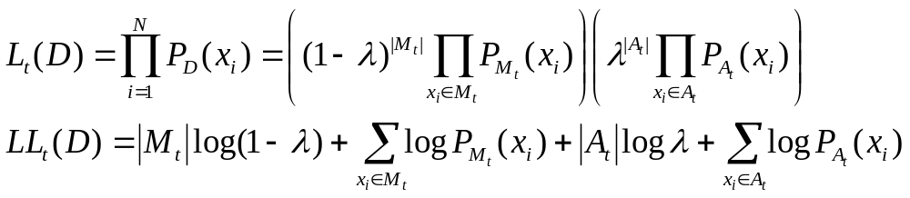
Statistical-based – Likelihood Approach
Data distribution, D = (1 – λ) M + λ A
M is a probability distribution estimated from data
  Can be based on any modeling method (naïve Bayes, maximum entropy, etc)
A is initially assumed to be uniform distribution
Likelihood at time t:

Slide 13
Both A and B are outliers

Slide 14
Limitations of Statistical Approaches
Most of the tests are for a single attribute
In many cases, data distribution may not be known
For high dimensional data, it may be difficult to estimate the true distribution

Slide 15
Distance-based Approaches
Data is represented as a vector of features
Three major approaches
  Nearest-neighbor based
  Density based
  Clustering based

Slide 16
Nearest-Neighbor Based Approach
Approach:
  Compute the distance between every pair of data points
  There are various ways to define outliers:
    Data points for which there are fewer than p neighboring points within a distance D
    The top n data points whose distance to the kth nearest neighbor is greatest
    The top n data points whose average distance to the k nearest neighbors is greatest

Slide 17
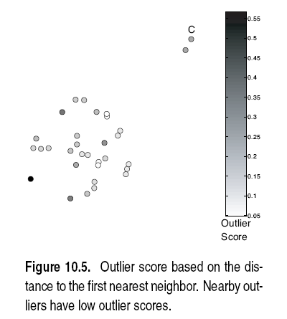

Slide 18
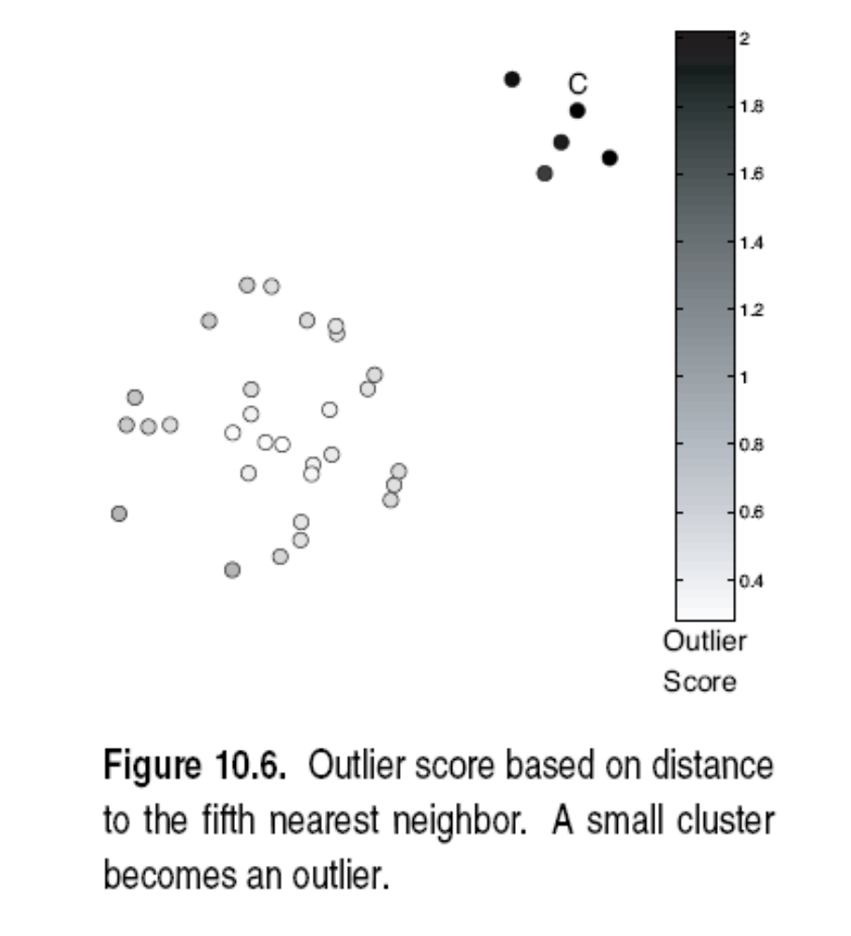

Slide 19
Outliers in Lower Dimensional Projection
In high-dimensional space, data is sparse and notion of proximity becomes meaningless
  Every point is an almost equally good outlier from the perspective of proximity-based definitions
Lower-dimensional projection methods
  A point is an outlier if in some lower dimensional projection, it is present in a local region of abnormally low density

Slide 20

Outliers in Lower Dimensional Projection
Divide each attribute into φ equal-depth intervals
  Each interval contains a fraction f = 1/φ of the records
Consider a k-dimensional cube created by picking grid ranges from k different dimensions
  If attributes are independent, we expect region to contain a fraction f^{k} of the records
  If there are N points, we can measure sparsity of a cube D as:
  Negative sparsity indicates cube contains smaller number of points than expected

Slide 21
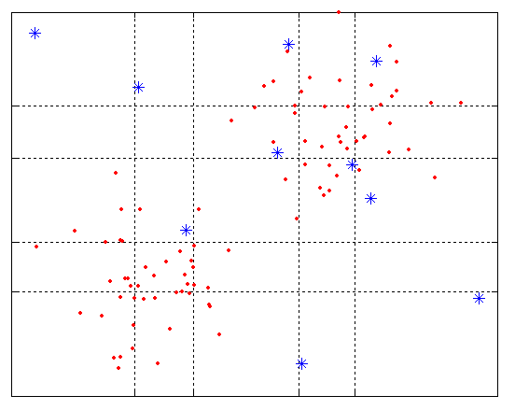
Example
N=100, φ = 5, f = 1/5 = 0.2, N × f² = 4

Slide 22
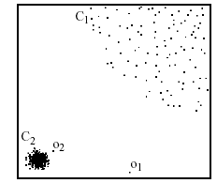
Density-based: Relative Density
For each point, compute the density of its local neighborhood
Compute local outlier factor (LOF) of a sample p as the average of the ratios of the density of sample p and the density of its nearest neighbors
Outliers are points with largest LOF value
In the NN approach, p₂ is not considered as outlier, while LOF approach find both p₁ and p₂ as outliers
p₂
×
p₁
×

Slide 23
Clustering-Based
Basic idea:
  Cluster the data into groups of different density
  Choose points in small cluster as candidate outliers
  Compute the distance between candidate points and non-candidate clusters.
    If candidate points are far from all other non-candidate points, they are outliers

Slide 24
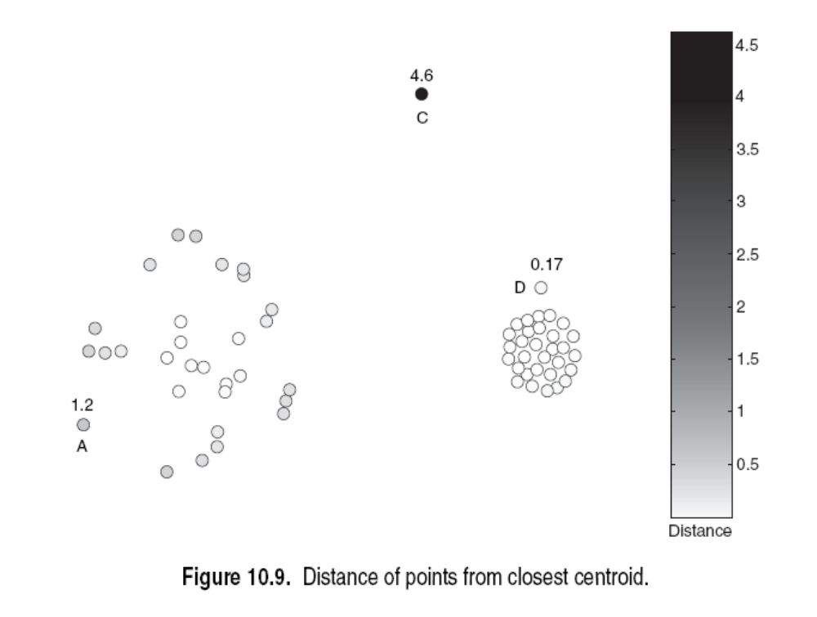
Euclidean distance

Slide 25
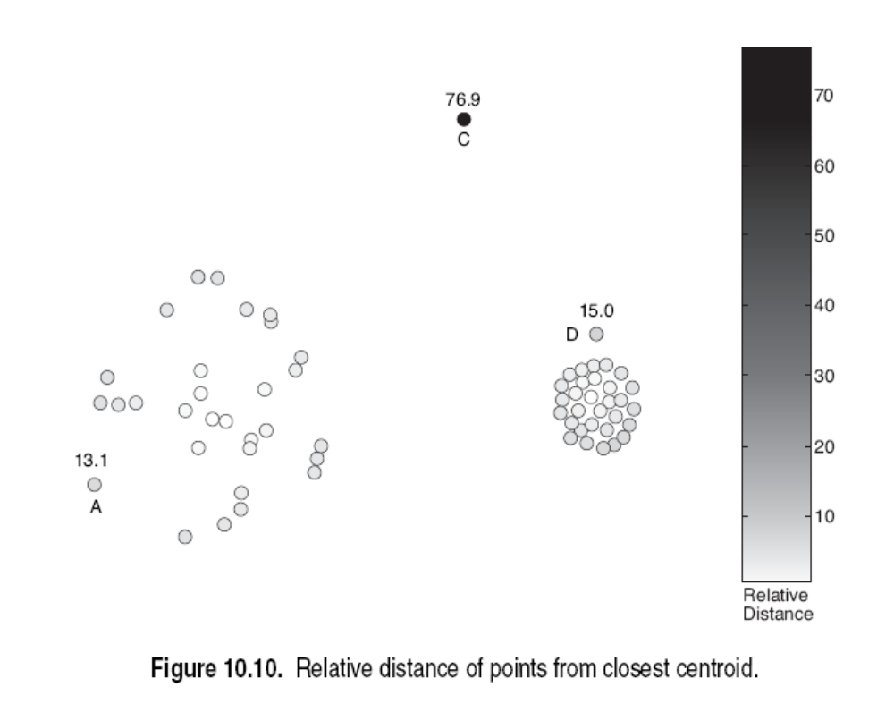
Mahalanobis distance

